Slide 1
Digital Marketing for workforce centers
National Forum member meeting 2023

Slide 2
Topics we can discuss
Website Basics and Best Practices
What Social Media Can and Cannot Do
Social Media Outlets to Consider
Tools to Make It Easier

Slide 3
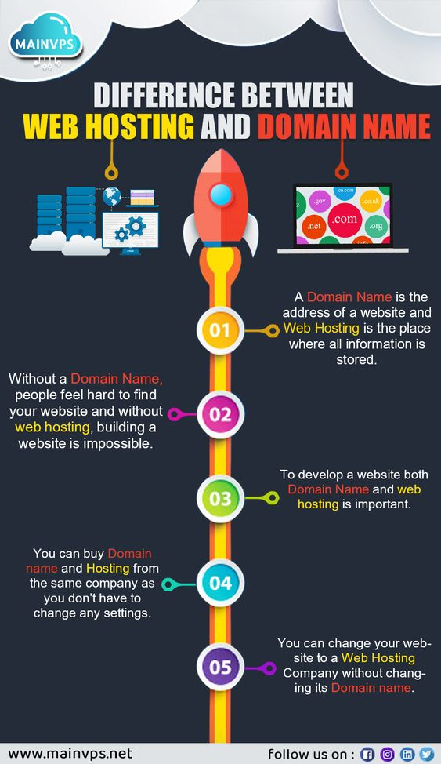
DOMAIN NAME
Whois.com
Godaddy.com
WEB HOSTING
Godaddy.com
Hostgator.com
Wpengine.com
Dreamhost.com
WEBSITE
Wordpress.com
Squarespace.com
WEBSITE THEMES
Avada
Divi
Wordpress

Slide 4
social media can
Provide a platform for engagement
Provide an outlet to connect with other organizations doing similar work
Connect to local media outlets
social media cannot
Be the only way to spread information on your work or events
Be a standalone referral service
Guarantee conversations with your audiences

Slide 5
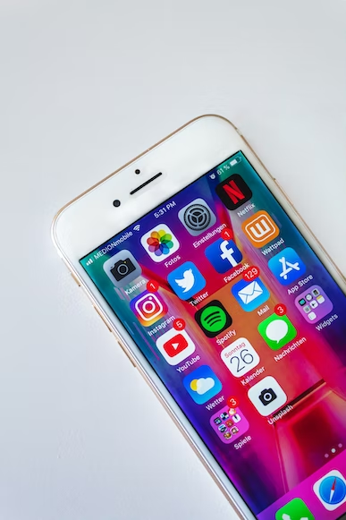
Social media sites (oregon’s experience)
Facebook: Good for connecting with individual nurses and organizations, and stirring up controversy
LinkedIn: More one-sided conversations with a professional tone
Twitter: Good for connecting to media
Things we haven’t tried yet
Instagram
TikTok
WhatsApp

Slide 6
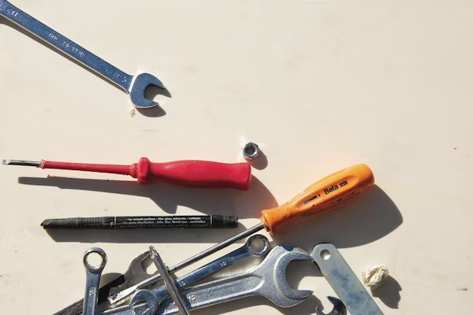
Tools to make it easier
Photography: Unsplash
Graphic Design: Canva or Adobe Spark
Scheduling: HootSuite or Buffer
TechSoup Tutorial: https://www.techsoup.org/community/events-webinars/social-media-101-for-nonprofits-with-adobe-spark-2019-12-10

