Slide 1
National Nursing Forum Sharing Session
August 19th, 2022, 1pm CT
Justice, Equity, Diversity, & Inclusion (JEDI) Committee

Slide 2
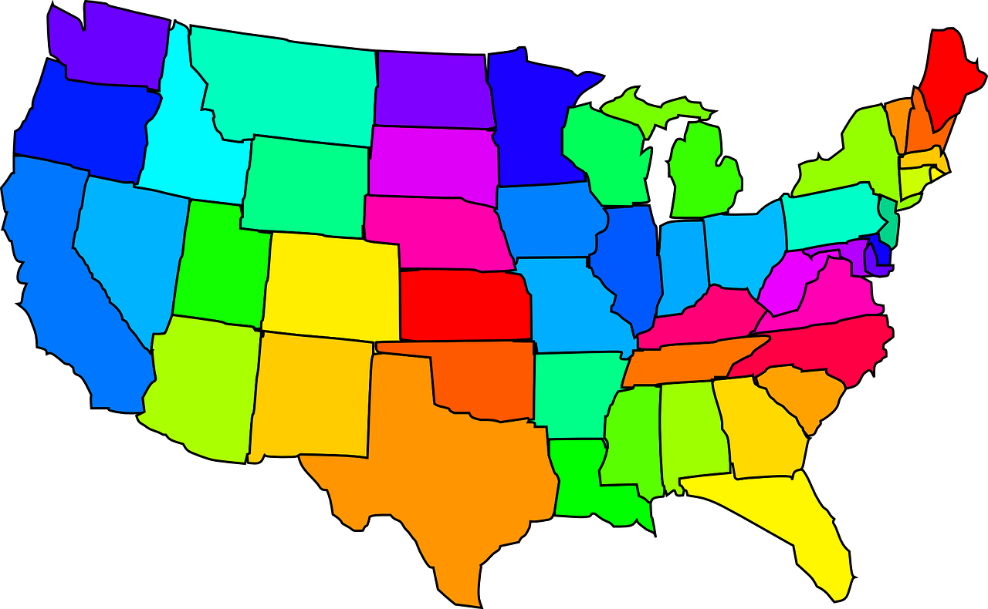
Who is JEDI?
Barbara Nichols (WI)
Sofia Aragon (WA)
Deb Elliot (NY)
Lisa Walters (NE)
Andrea Bresnahan (MA)
Jenny Horn (PA)
Eddie Burns (CA)
Need Gulf-Southeast Representation
Meggin Lorino (NM)

Slide 3
Diversity
Definition of Diversity: all the ways in which we are similar and/or different. Diversity and inclusion encompass any dimension of human differences or similarities, including but not limited to: cultural, cognitive, and social variables that differentiate groups or people from one another (e.g., race, ethnicity, gender, age, sexual orientation, ability, geographic location).

Slide 4
Purpose
The National Forum of State Nursing Workforce Data Centers (Forum) statement of purpose regarding justice, equality, diversity and inclusion:
The Forum is the national expert and voice for nursing workforce data and represents nursing workforce centers across the nation.
A robust and well-prepared nursing workforce must represent the communities in which it serves.
Therefore, the Forum is committed to:
Representing any human difference or similarity of the nursing workforce (i.e, race, ethnicity, gender, age, sexual orientation, ability, geographic location, etc.) in its mission and work; and
Promoting equality in all written, electronic, or verbal communication; and
Embracing diversity and inclusion in its membership; and
Addressing concerns related to misrepresentation or injustice in a timely, fair, and respectful manner.

Slide 5
Unity Statement
Our nation has undergone historic shifts in perspective and a new reckoning on health equity and justice for marginalized populations. Over the past two years, our nation has witnessed the disparate impact of COVID on already marginalized communities; the murders of Ahmand Aubrey, Breonna Taylor, George Floyd, Elijah McClain, Ma’Khi Bryan, along with too many other Black men & women; and, most recently, a mass shooting perpetrated by a self-proclaimed neo-Nazi. The Code of Ethics for Nurses with Interpretive Statements obligates all nurses to be allies and to advocate for and speak up against racism, discrimination, and injustice. The National Forum of State Nursing Workforce Centers (Forum) aligns ourselves with the American Academy on Nursing (Academy), American Nurse Association (ANA), and many other state and national nursing organizations to recognize that racism is a public health crisis.
The mission of the Forum is to lead a national network to ensure a robust and well-prepared nursing workforce. The Forum represents 80% of the nursing workforce centers across the nation. It focuses on addressing the nursing shortage within their states and contributes to the national effort to assure an adequate supply of qualified nurses to meet the health needs of the US population. We support the advancement of new as well as existing nurse workforce initiatives and share best practices in nursing workforce research, workforce planning, workforce development, and formulation of workforce policy.
The nursing profession has a moral imperative to uphold equitable practice from the boardroom to the bedside. The Forum is committed to creating space for dialogue, discovery, and relevant examination to address how racism influences the meaningful work nurses do every day.

