Slide 1
Nurse Practitioner Workforce Shifts in a Decade of Policy, Payment, and Practice Changes: a 2005-2015 comparison
Mary Val Palumbo DNP, APRN
AHEC Office of Nursing Workforce
University of Vermont
Betty Rambur, PhD, RN, FAAN
Routhier Endowed Chair for Practice and Professor of Nursing
University of Rhode Island

Slide 2
LEARNER Objectives
Describe nurse practitioner (NP) work settings/demographics in a decade of policy changes, including adopting provider risk-bearing for the cost of care.
Describe NP work settings/demographic changes in a state that adopted administrative rules to enable independent NP practice.

Slide 3
PURPOSE
To describe NP practice in a decade of policy changes that include the Patient Protection and Affordable Care Act of 2010 (ACA), Administrative Rule changes enabling independent NP practice (2011), and legislatively supported steps away from fee-for-service and to value-based care (2011).

Slide 4
Background
Health reform toward the Triple Aim requires robust primary care integrated with behavioral health and enhanced care coordination. Advanced Alternative Payment Models (AAPMs) layer additional provider accountability for cost-of-care and, through laws like Medicare Access and CHIP Reauthorization Act (MACRA), AAPMs offer financially incentivized approaches to value-based care delivery.
Notes:
Betty

Slide 5
Background :Additional context
Setting is an early adopter of care coordination for chronic conditions (2006), which became the basis for a statewide primary care focused patient centered medical home program called Vermont Blueprint for Health
Includes payment for residential support program initially termed Seniors Aging Safely at Home, now Support and Services at Home

Slide 6
Background :Additional context
Aggressive movement toward electronic health record interoperability in all settings, Vermont Technology Leaders (VITL)
Legislatively authorized move away from Fee-for Service
$45 M SIM grant testing bundled payments and Accountable Care Organizations
Legislatively supported Single Payer that evolved to an All Payer, Total Cost of Care Model
Empirical testing of behavioral health integration ($18.5 M, PCORI grant, Littenberg PI)

Slide 7
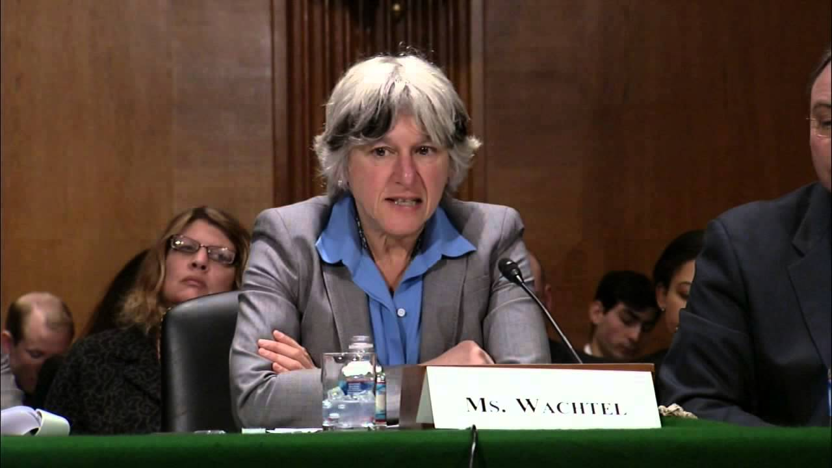
Background - Full Practice for VT. APRNs
June 1, 2011 - VT Nurse Practice Act was changed to support full practice authority for VT NPs
Collaborative practice agreement with another NP, MD or DO is required until the APRN has completed the 2400-hour and 2-year transition to practice period

Slide 8
Methods
This secondary analysis design study compared decadal reliensure self-report Minimum Data Set NP workforce data (2005 n =260 80% response rate, 2015 n= 456; 100% response rate). Only NPs who currently reported working in-state were analyzed.

Slide 9
results
There was a sizable headcount increase in working NPs over the decade.
Statistically unchanged was the mean age, gender, race (95% white).
2005 MEAN AGE 49 2015 MEAN AGE 50
5%
Notes:
80% response rate in 2005….scaled to 100 it is 306....

Slide 10
Results
No significant change in the number with doctorates
OR
enrollment in an educational program (5%).

Slide 11
RESULTS
A statistically significant increase in the percentage certified in psych-mental health
( p=.002)

Slide 12
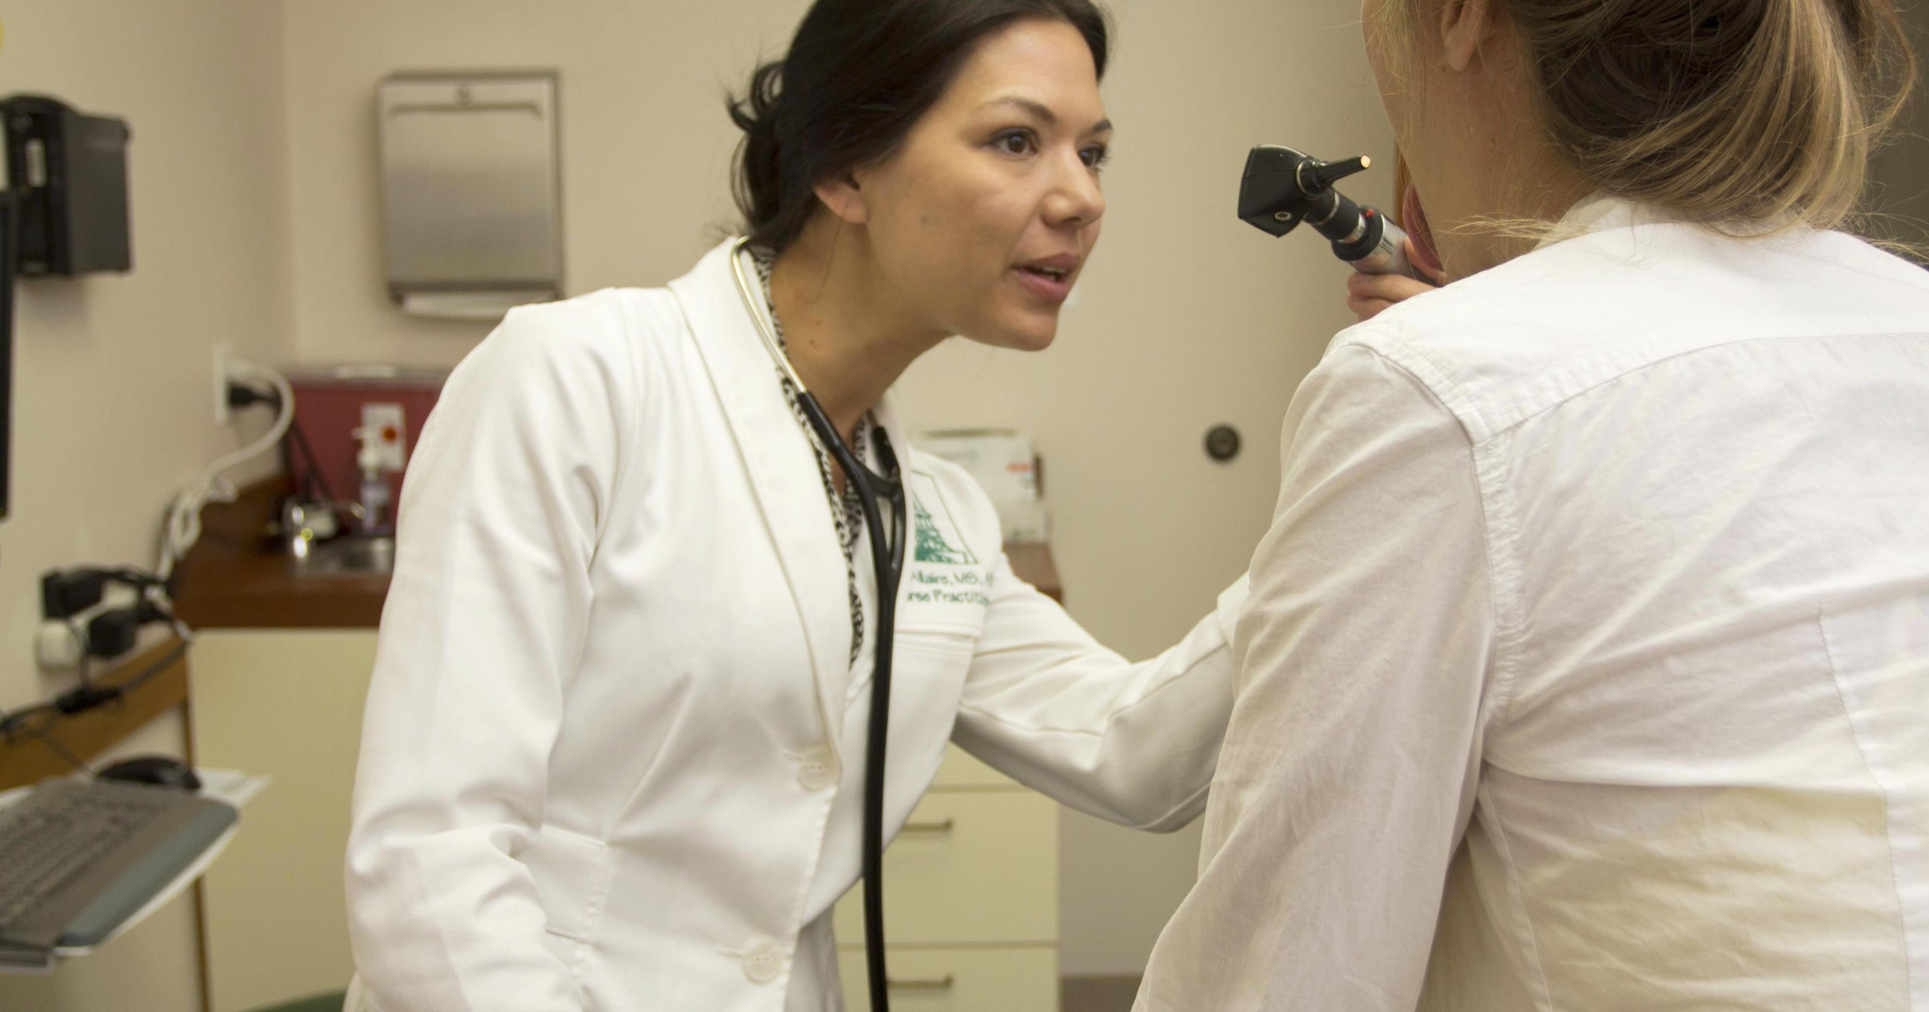
results
There was a significant change in reported settings from 2005 to 2015 (p<0.001) attributed to the following:
There was an increase in those reporting practicing in APRN group setting:
In 2005 (1) 0.4% and in 2015 (16) 3.9%
Notes:
Put in numbers

Slide 13
Results
There was a decrease in the percent reporting working in an MD/APRN setting:
In 2005 (107) 41.6% and in 2015 (131) 31.8%
There was an increase in the percent reporting working in a hospital outpatient setting:
In 2005 (35) 13.6% and in 2015 (79) 19.2%
Hospital Inpatient setting remained the same at 8.5%
Solo practice remained the same at 2.5%

Slide 14
Conclusions
Despite predictions that primary care providers would exit the state due to the proposed health care reforms, the nurse practitioner numbers increase by greater than 50% over the decade of health reform and NP full practice authority.
Notes:
Can we say 50%? There is an 80 percent response rate in one slice, for example

Slide 15
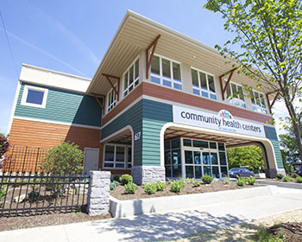
conclusions
Although many variables may impact these findings, these data suggest that policy reforms can enhance opportunities for NP care delivery, including in NP-led practices, ACO-affiliated hospital outpatient settings, and in high-need areas such as mental health.

Slide 16
Conclusions/Discussion
Increase # of Psych/Mental Health NP’s …..where did they come from???
This is curiously given that the state’s only psych-mental health NP program has held admissions since 2010 and 11 graduates from that program represent 29% of the Psych NP workforce.

Slide 17
Conclusions/Discussion
More online programs??
Importing psych mental health nurses into the state due to change in practice rules??
More Demand increased Supply???

Slide 18
conclusions
Trends away from APRN/MD practices parallel MD trends, likely in response to required cost/outcomes reporting and anticipation of financial risk-bearing in AAPM or MIPs measurement/reporting requirements.
Notes:
Only 37% of providers claimed to be independent in 2013, down from 57% in 2000.[3]
The Accenture Study is available at https://www.accenture.com/us-en/insight-clinical-care-independent- doctor-will-not-see-you-now
I can’t access this study????
________________________________________

Slide 19
Implications - practice
Full practice authority for Vermont nurse practitioners includes a 2 year period of collaborative practice with another NP, an MD or a DO.
These data suggest that this has not limited but might have enhanced the growth of the nurse practitioner workforce in the study setting.

Slide 20
Implications - education
More DNPs than PhD APRNs.
More NPs are working in NP groups. Are educational programs preparing NPs for that role?
Solo NP practice continues to be present. Are there adequate educational opportunities to prepare NP‘s for this?

Slide 21
Implications - policy
The Federal Trade Commission Staff Report (2014) notes that state policy makers should be wary of limiting scope of practice for nurse practitioners
These data illustrate trends that support access in a state allowing nurse practitioners to practice to their full scope in a setting undergoing dramatic delivery shifts

Slide 22
Limitations
Small rural state, limits generalizability
Small numbers overall
Many factors likely influence the NP workforce
Descriptive study of two cohorts—unable to tease out interaction effects
80% response rate in 2005—are non-responders different than responders?
Instrument has some inherent limitations, e.g., measures headcount not FTEs

Slide 23
Further research
Does the increase in nurse practitioners impact access to primary care?
Does access vary by payer type?
Richards and Polsky (2016) found that states with broader NP scope had easier access to primary care, using the ”secret shopper” approach
Access is to be evaluated as part of the testing of the All-Payer Mode, but the planned approach is a telephone survey of patient self report; regrettably, much of the planned evaluation uses the term “physician”

Slide 24
Further REsearch
To what extent are NP opportunities emerging because MDs are not choosing primary care or are unwilling to adopt the IT, quality, and reporting infrastructure advanced alternative payment models require?
This study looks only at numbers of NPs. Analysis of NP roles in emerging delivery models is essential.

Slide 25
Questions????
Betty Rambur, PhD, RN, FAAN
Routhier Endowed Chair for Practice
Professor of Nursing
College of Nursing
White Hall
39 Butterfield Road
University of Rhode Island
Kingstown, RI 02881 USA
brambur@uri.edu
Mary Val Palumbo DNP, APRN, GNP-BC
Associate Professor
Department of Nursing
University of Vermont
AHEC Nursing Workforce Initiatives
Co-Chair Vermont Action Coalition
106 Carrigan Drive
Rowell 231E
Burlington VT 05405-0068
(802) 656-0023
Mary.palumbo@uvm.edu

